Slide 1


Scalability in Practice: a Highly scalable web app
SE3331 (2025 Fall)
Xingda Wei / Yubin Xia
IPADS, Shanghai Jiao Tong University
https://www.sjtu.edu.cn

Slide 2




Scalable web apps are everywhere: pre-AI era
High request rate
  100 billions of requests daily
Massive data
  Facebook has more than 1 billion of images uploaded weekly, Baidu stores tens of billions of web pages
Transparent scale
  The system performs seamlessly no matter how the workloads scale

Slide 3

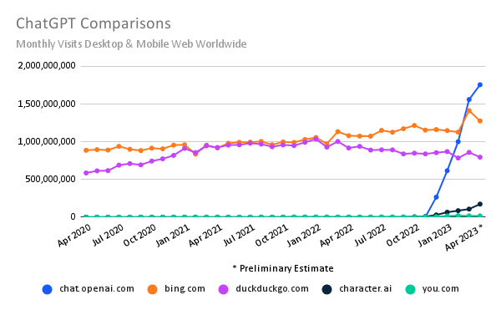
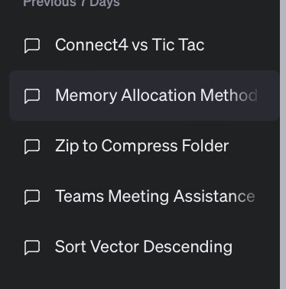
Scalable web apps are everywhere: AI era
Essentially, also a web APP
  Pre-AI era: request handling = order an item
  AI era: request handling = use model to do one or multiple inferences
The same system requirements
  High request rate
  Massive data: both for training & for serving
  history data
  Transparent scaling
New requirements
  Huge computation power required
  According to GPT (☺), an inference of GPT
  ~= sorting 100,000,000 numbers
Per-user sessions

Slide 4


Transparent scale is challenging
What does server is busy means?
  Especially when the usage increases
To answer these questions, we need to see how modern services are built!

Slide 5
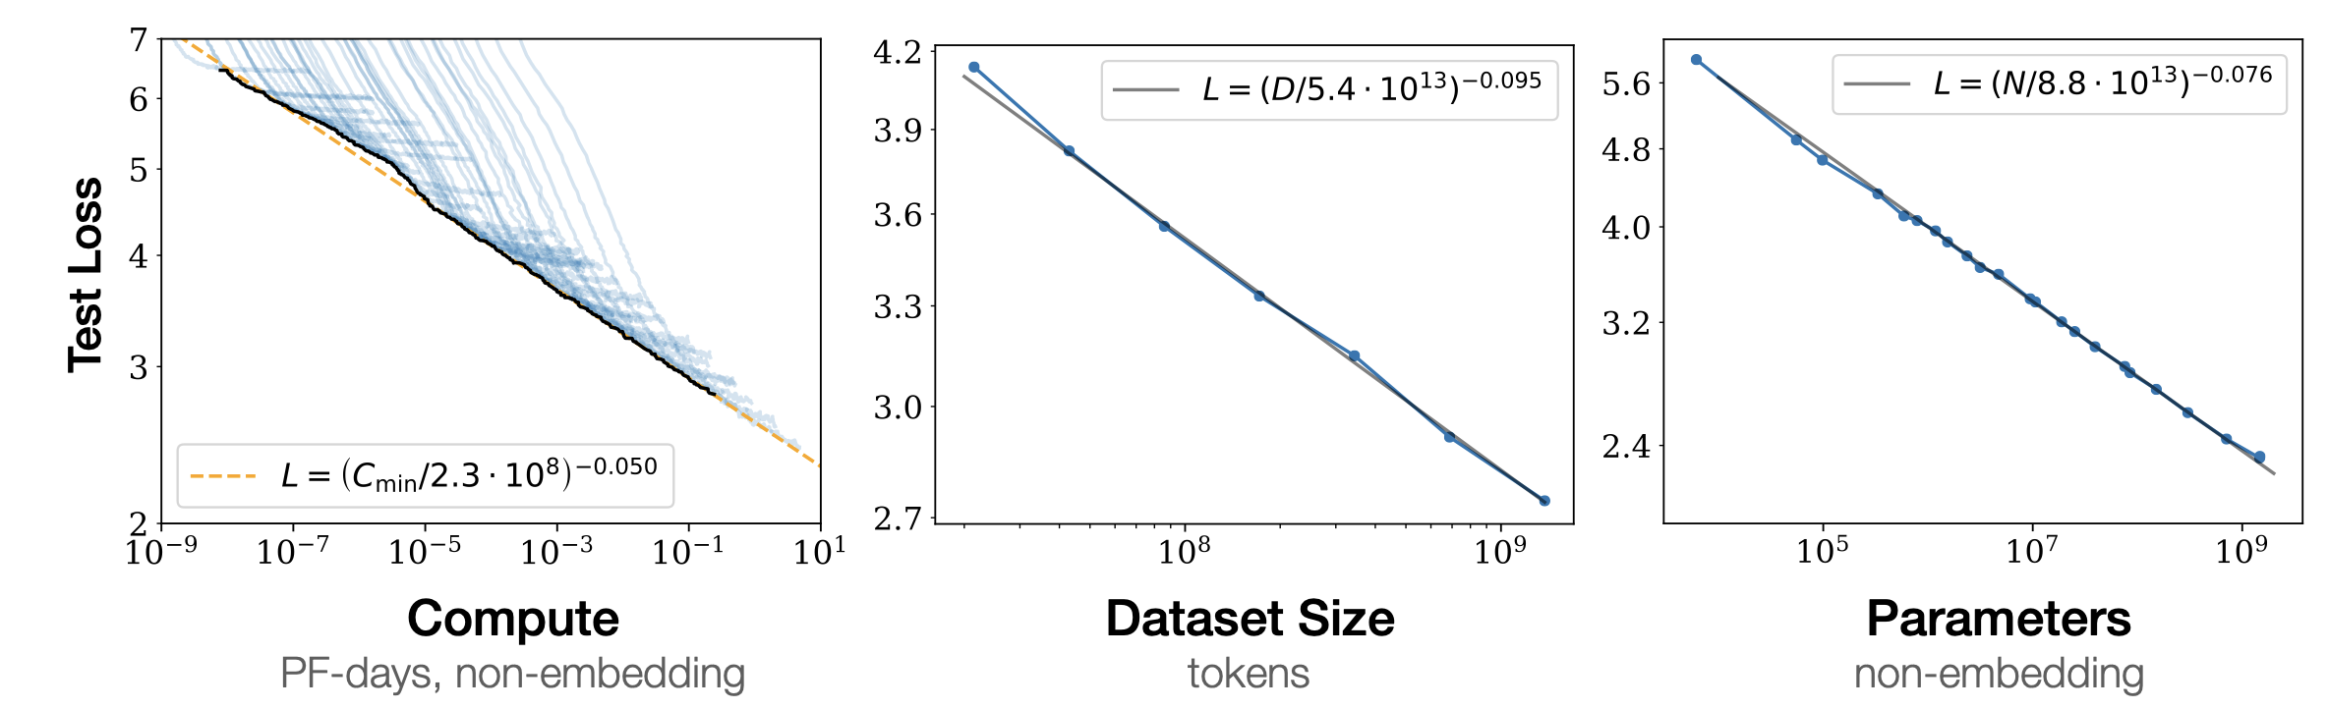
Scalability is everywhere in computing systems
Example: scaling law
  Massive data needed (the larger, the better)
  Massive model needed (the larger, the better)
  Massive computation power needed

Slide 6
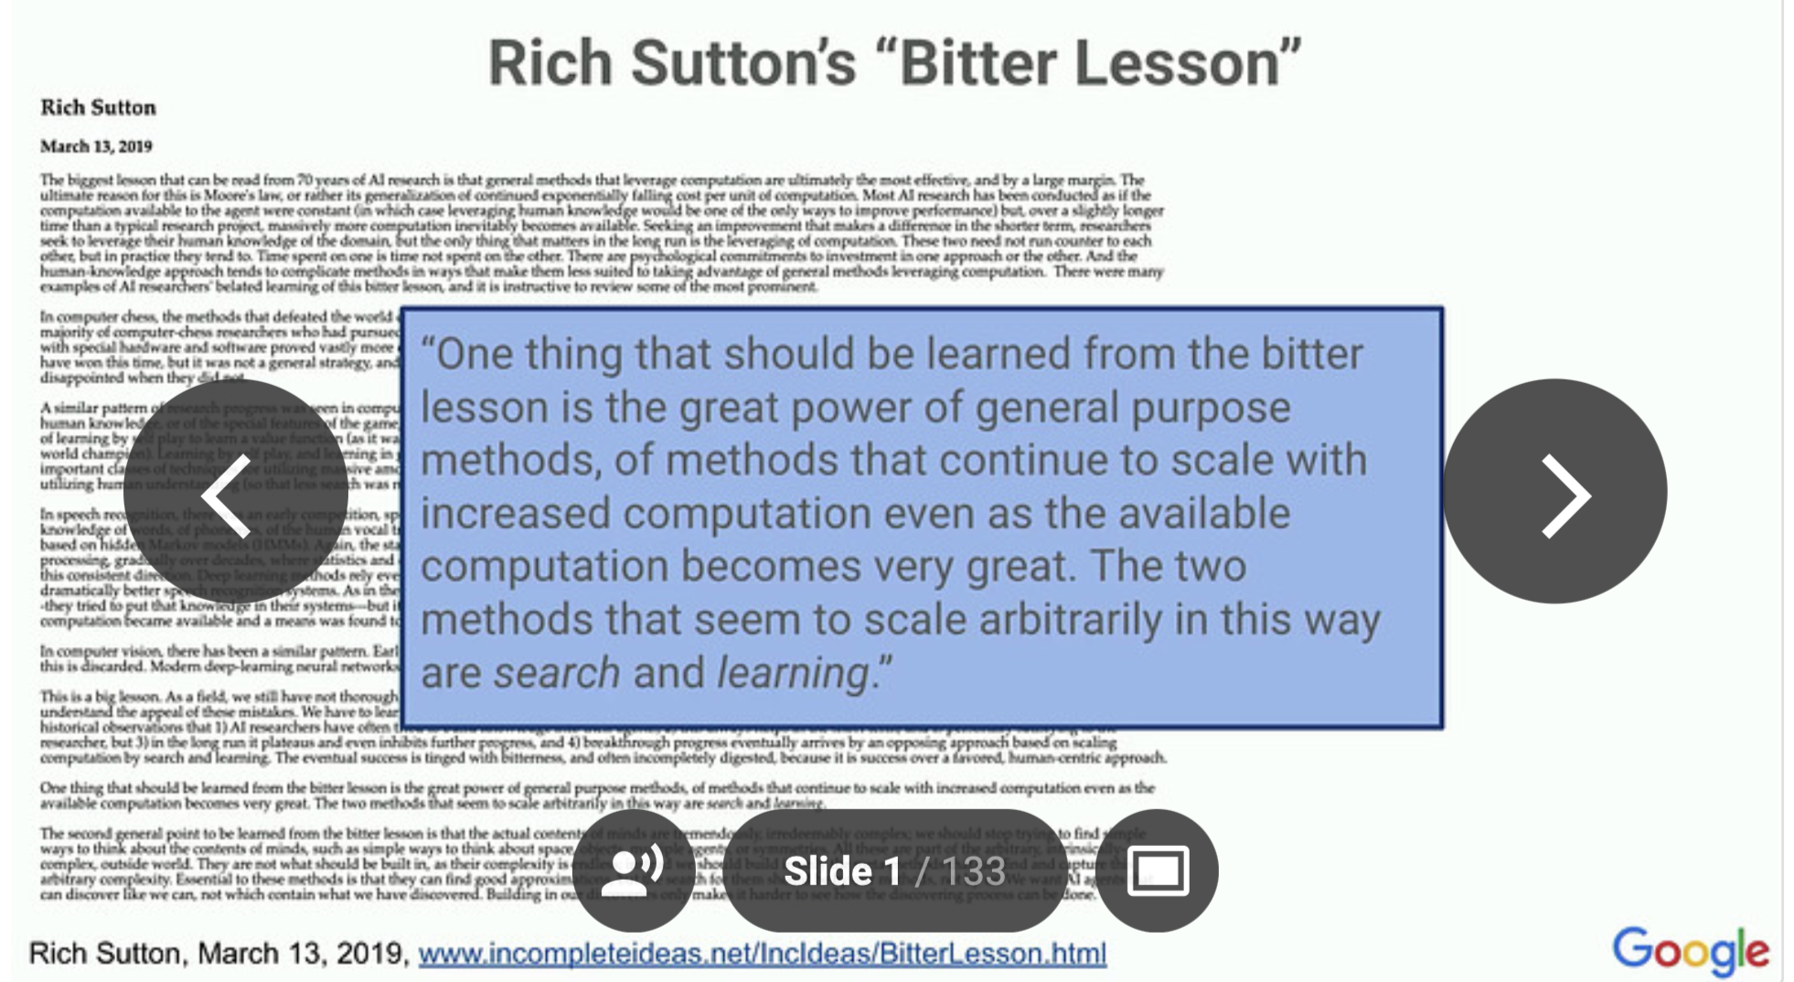
Example: Bitter Lesson

Slide 7
Yet, the key principles & techniques in building scalable system is similar: i.e., we need to build a distributed (and parallel) system
Notes:
2003 年马云 创建淘宝

Slide 8

Case study:
An e-commerce web application
Notes:
2003 年马云 创建淘宝

Slide 9

Each click needs thousands of servers to cooperate
Caching server
Caching server
…
Caching server
Caching
Caching
Caching
Distributed caching
Database server
Database server
CDN
Users
Application #1
generate the page
Database
user, price
…
Database
user, price
Application server
Distributed database
Internet
Load
Balance
Application #2
add the order
File server
File server
File server
File:
image
File:
image
…
File:
image
Application server
…
…
Message queue
Distributed file system

Slide 10
How to build Taobao on a single machine (in old days)?
Operating system:
  Linux (in OS class)
Serving the requests: web server
  Apache, Nginx (in ICS)
Serving the data: file system & DB
  MySQL & inode file system (in CSE)
Displaying the page: HTML
  PHP (in Web class)
LAMP = Linux + Apache + MySQL + PHP

Slide 11
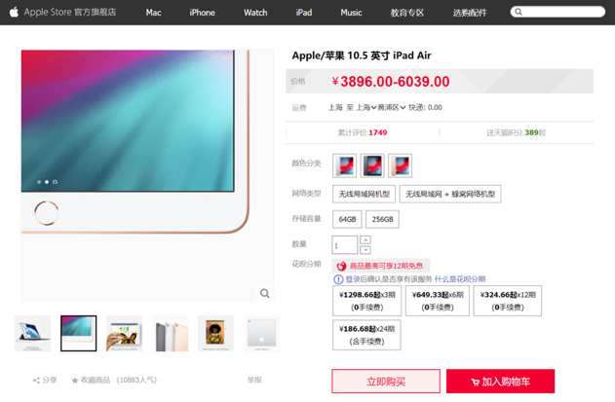
Using one server to build Taobao
https://www.taobao.com
Internet
Application
generate the web page
File:
image
Database:
user, price
Server

Slide 12
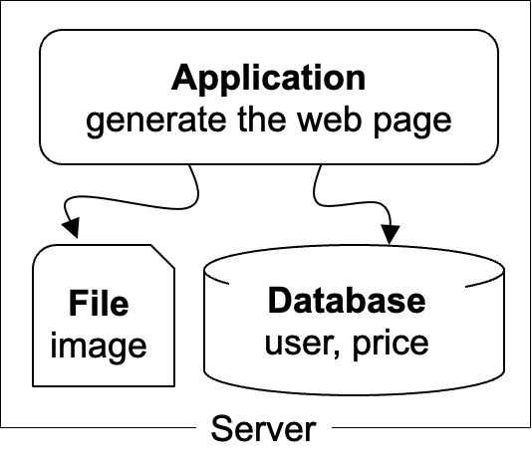
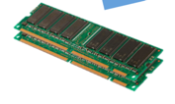
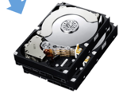
The architecture of LAMP scales poorly!
https://www.taobao.com
Internet
The disk & memory of one server cannot store massive amount of data
  DRAM: 64 – 256 GB
  HDD: 2 – 40 TB
  Facebook has more than 1 billion of images uploaded weekly, Baidu stores tens of billions of web pages
File:
image
Database:
user, price
DRAM
HDD

Slide 13

Step #1 for scalability: disaggregating application & data
Database: requires reading/writing disk & cache
  Can be scaled with faster disks & larger memory
File system: store large bulks of data
  E.g., images, videos
  Can be scaled with faster disks
Vendors like Oracle provides databases/filesystems support with huge volumn
Application
generate the web page
Application server
Local area network
File server
Database server
Scale
Scale
File:
image
Database
user, price
Database
user, price

Slide 14
Step #2 Avoid the slow data accesses? Caching
Observation: most requests access
a small portion of the data (locality)
Caching system with a single node:
  E.g., page cache
  Drawbacks: limited DRAM capacity
Distributed caching server
  Benefits: huge DRAM capacity, e.g., deploy many caching servers
Application
generate the web page
Application server
Local area network
Caching server
Caching server
Caching
Caching
File server
Database server
File:
image
Database
user, price

Slide 15
Case study of distributed cache server: Memcached
Distributed caching server
  Benefits: huge DRAM capacity
Memcached server
  Store all the cached data in memory
  Can scale out to use multiple servers
Memcached clients
  Check whether server has cached data
  On cache miss, fallback to database/file
Question:
  How to find which server has cached the data?
Application
generate the web page
Net
Comm
Memached API
S0: 10.0.0.100
S1: 10.0.0.101
Routing
Application server
Local area network
Caching server#0:
10.0.0.100
Caching server#1:
10.0.0.101
Caching
Memached
Caching
Memached

Slide 16
Case study of distributed cache server: Memcached
Naïve method, hashing:
  address = Hash(key) % #server
Problem:
  What if we add a new server?
  Suppose that we add server from 3→4
  Then there would be ~50% miss!
Solution: consistent hashing
  Suppose that we add server from 3→4
  It will only incur < 25% miss
  More details in later lectures
How to find the data?
Consistent hashing

Slide 17
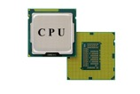
The architecture of LAMP scales poorly!
https://www.taobao.com
Internet
Application uses the CPU for processing, while a single CPU can hardly scale due to the end of Moore’s law & Dennard scaling
  Moore’s law: the number of transistors in a dense integrated circuit (IC) doubles about every two years.
  Dennard scaling: as transistors get smaller, their power density stays constant
Application
generate the web page
Notes:
摩尔定律：元器件上的元器件翻倍
Dennard： 尺寸缩小，能耗降低

Slide 18
Step #3 for scalability: more app servers
Internet
We can add more servers for scaling its performance
  Simple for stateless jobs (e.g., web service)
What is stateless?
  The server only executes the logic that only relies on input data but no long-term state
We can do so for stateful jobs but requires more work ☺
Application
generate the web page
Application
generate the web page
Application
generate the web page
Application server #N
Application server #N
Application server #N
Local area network
Caching server
Caching server
Caching
Caching
File server
Database server
File:
image
Database
user, price

Slide 19
Step #3 for scalability: How to do the load balance?
  Load balance: how to route the user quests to the application servers?
  Leverage the network layer
  HTTP redirection,
  reverse proxy,
  …
  Load balance algorithms
  round-robin,
  random,
  hashing,
  …
Internet
Load balancer
Application
generate the web page
Application
generate the web page
Application
generate the web page
Application server #N
Application server #N
Application server #N

Slide 20
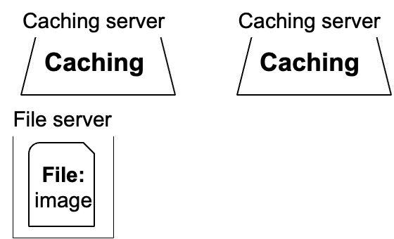
Step #4 for scalability: distributed databases
#1. Separate the database for read/write
  E.g., use primary-backup replication
  The primary servers the writes and backup only serves reads
#2. Separate a table on multiple databases
  e.g., a bank has reported that a single table has 100,000,000 rows
  However, split a table on multiple machines complex consistency management
Application
generate the web page
Application
generate the web page
Application
generate the web page
Application server #N
Application server #N
Application server #N
Local area network
Write
Read
Database server
Database server
Database
user, price
Database
user, price

Slide 21
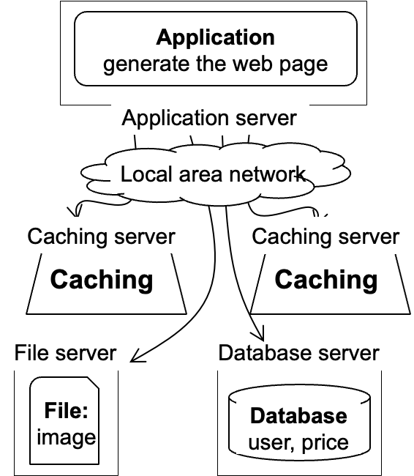
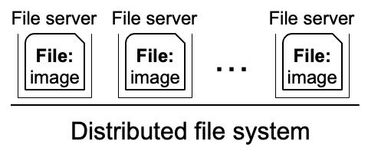
Step #5 for scalability: distributed file system
Using multiple database in principle makes the database distributed
We can use a similar approach to make the file system distributed !
Well-known distributed file system
  NFS (Network file system)
  GFS (Google file system)
  HDFS
  Ceph
  Etc.
Application
generate the web page
Application server
Local area network

Slide 22
Summary: scalable website so far
The compute/storage is processed on multiple servers' w/ disaggregation
  Independently scaled according to requirements
Each time it scales, a new problem may arise
Caching server
Caching server
…
Caching server
Caching
Caching
Caching
Distributed caching
Database server
Database server
Users
Application #1
generate the page
Database
user, price
…
Database
user, price
Application server
Distributed database
Internet
Load
Balance
Application #2
add the order
File server
File server
File server
File:
image
File:
image
…
File:
image
Application server
…
…
Message queue
Distributed file system

Slide 23

Step #6 for scalability: using CDN
Goal: return the results to user as soon as possible
  Why? Amazon has reported that 100ms latency increase will cause 1% financial loss
Core idea: caching (again)
  E.g., CDN (content delivery network) caches the content at the network providers, which is closer to users
  Challenge: how to do it without users’ awareness?
CDN
Users
Application
generate the web page
Internet
Application server
…
Notes:
Example: jquery

Slide 24


Step #7 for scalability: separate different applications
Use dedicated servers for different applications
  Question: How to run different servers on top of the same hardware?
  Containers w/ K8S (In other courses)
Application #1
Alipay
Internet
Application server
Application #2
Taobao
Application server

Slide 25


How to handle complex requests?
Example: after the website becoming larger, handling requests is far more than displaying a (static) web page
Alipay (支付宝)
  E.g., fraud detection
Taobao
  Hot list (热榜)
  Dynamic product ads (千人千面)
  Recommendation (you might also like)
  …
Hot lists
Customized ads

Slide 26
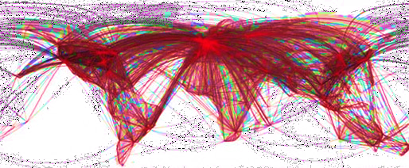

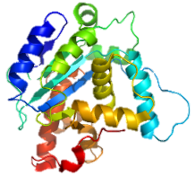

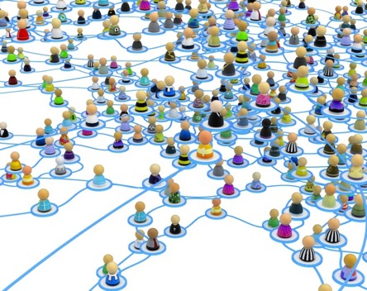


Use distributed computing frameworks for complex queries
General batch processing systems
  MapReduce, Spark, etc.
Graph processing systems
  GraphLab, Pregel, etc.
AI systems
  Pytorch, vLLM, Megatron, etc.

Slide 27
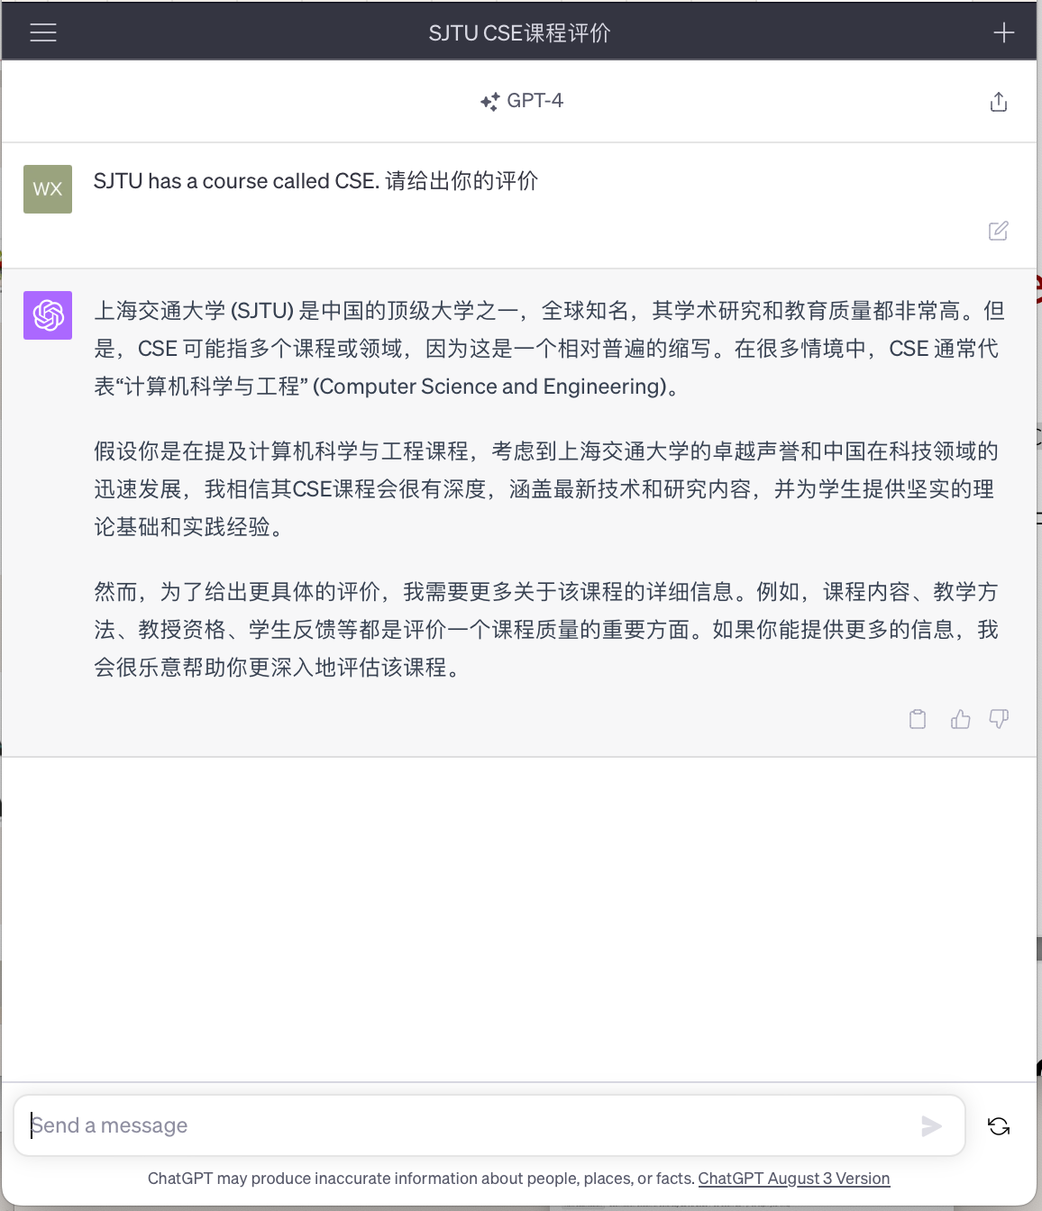
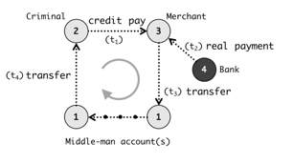

Step #7: separated applications + distributed computing
Example (Each system is backed by multiple machines)
  Use general batch processing system to generate hot list
  Use graph system to detect credit card fraud
ML framework
e.g., Pytorch, Deepspeed
Application #3
Chatbot
Application server
Application #1
Alipay
Graph processing
e.g., GraphLab
Internet
Application server
Generate hot lists
Application #2
Taobao
Batch processing
e.g., MapReduce
Application server

Slide 28
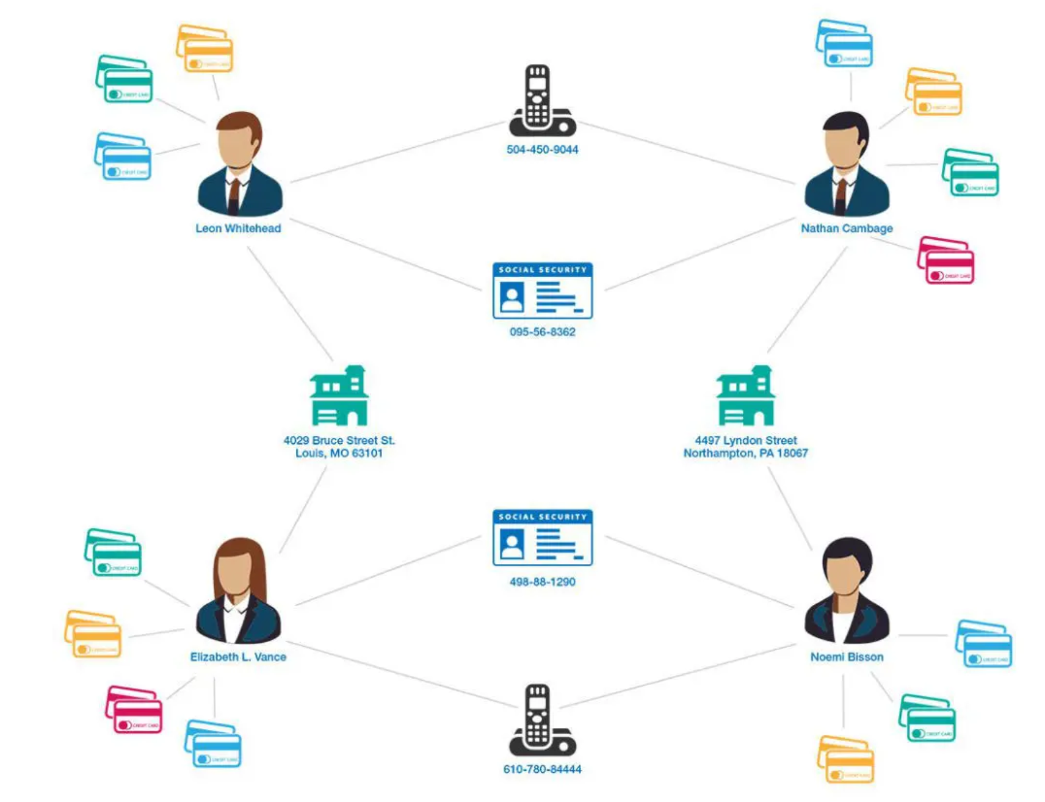
Computation frameworks to support different services
Hot topics
Fraud detection
Chat Bot
Scalable graph processing system
Source: https://www.graphable.ai/blog/graph-database-fraud-detection/
Scalable batch processing system
Scalable ML/AI systems

Slide 29
A scalable website: powered by distributed (parallel) systems!
Distributed system: A distributed system is a collection of independent computers that appears to its users as a single coherent system.
- DISTRIBUTED SYSTEMS Principles & Paradigms, Second Edition
Caching server
Caching server
Caching server
…
Caching
Caching
Caching
Distributed caching
Database server
Database server
CDN
Users
Application #1
generate the page
Database
user, price
…
Database
user, price
Application server
Distributed database
Internet
Load
Balance
Application #2
add the order
File server
File server
File server
File:
image
File:
image
…
File:
image
Application server
…
…
Message queue
Distributed file system

Slide 30
Modern scalable system systems are
large & distributed
Powered by large-scale datacenter

Slide 31
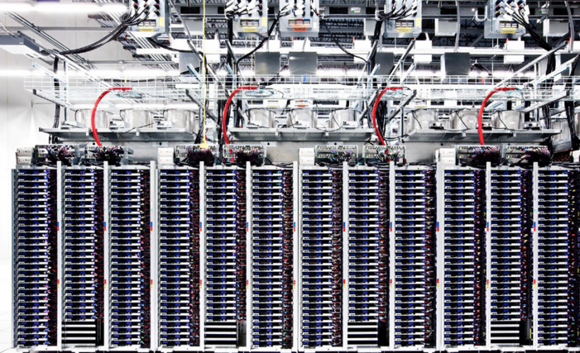
Scalable websites are powered by modern datacenters
Large server and storage farms
  CPUs/GPUs/XPUs: > 20,000,000 cores
  Disk capacity: > 1,000,000 GB
  10-100 MW of power -> 1.1GW (AI cluster)
Caching server
Caching server
…
Caching server
Caching
Caching
Caching
Distributed caching
Database server
Database server
CDN
Users
Application #1
generate the page
Database
user, price
…
Database
user, price
Application server
Distributed database
Internet
Load
Balance
Application #2
add the order
File server
File server
File server
File:
image
File:
image
…
File:
image
Application server
…
…
Distributed file system

Slide 32
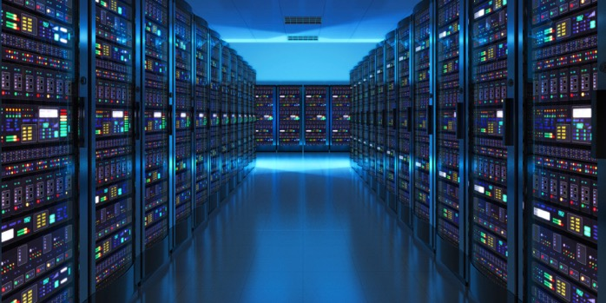
Datacenters that power the scalable website
Large-scale distributed systems: 10K – 100K servers
  Each rack: 40 servers (Fewer if w/ GPU)
Complex networking for connecting servers
  To cooperate, we must communicate
Source: “The Datacenter as a Computer --- An Introduction to the Design of Warehouse-Scale Machines”

Slide 33
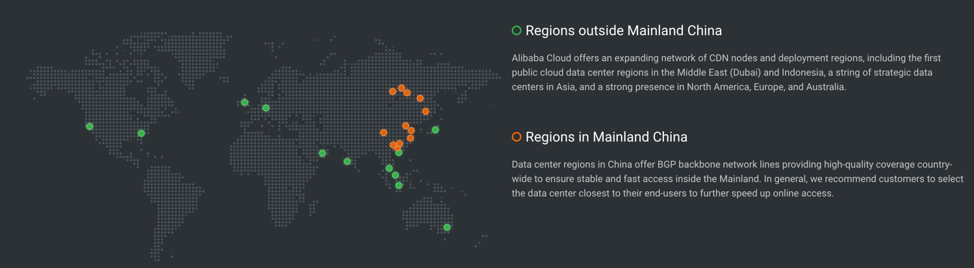
Datacenters are geo-replicated
The locations of Alibaba datacenters
Source: https://www.alibabacloud.com/zh/global-locations

Slide 34
Design large-scale distributed system is challenging
Fault is common, how to handle it?

Slide 35
Fault is common: fault, error, failure
Fault can be latent or active
  if active, get wrong data or control signals
Error is the results of active fault
  e.g. violation of assertion or invariant of spec
  discovery of errors is ad hoc (formal specification?)
Failure happens if an error is not detected and masked
  not producing the intended result at an interface
Notes:
SDC：乘法加速器比较容易出bug

Slide 36
Fault is common
, especially in large distributed systems
Why faults are common especially in distributed systems? Scale!
  “Suppose a cluster has ultra-reliable server nodes with a stellar mean time between failures (MTBF) of 30 years (10,000 days)—a cluster of 10,000 servers will see an average of one server failure per day. ”
Source: The Datacenter as a Computer
-- An Introduction to the Design of Warehouse-Scale Machines

Slide 37


Fault is common
especially in large distributed systems
What are the causes?
Why faults are common especially in distributed systems? Scale!
  “Suppose a cluster has ultra-reliable server nodes with a stellar mean time between failures (MTBF) of 30 years (10,000 days)—a cluster of 10,000 servers will see an average of one server failure per day. ”
Causes:
  Operation error (human, configuration, etc.)
  Software error (e.g., bug)
  Hardware error
  Power outage
  Natural disaster
Source: The Datacenter as a Computer
-- An Introduction to the Design of Warehouse-Scale Machines

Slide 38
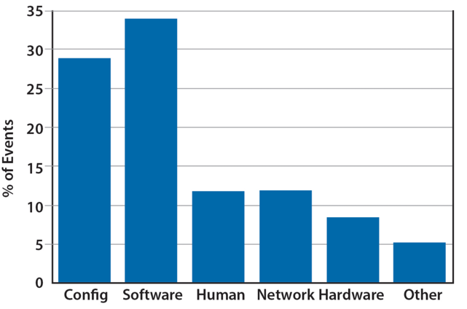
Fault is common
especially in large distributed systems
What are the causes?
Why faults are common especially in distributed systems? Scale!
  “Suppose a cluster has ultra-reliable server nodes with a stellar mean time between failures (MTBF) of 30 years (10,000 days)—a cluster of 10,000 servers will see an average of one server failure per day. ”
Causes:
  Operation error (human, configuration, etc.)
  Software error (e.g., bug)
  Hardware error
  Power outage
  Natural disaster
Source: The Datacenter as a Computer
-- An Introduction to the Design of Warehouse-Scale Machines

Slide 39
Faults and partial failures
On a single computer, it either works or it doesn’t
But in a distributed system, some parts of the system can be broken in some unpredictable way
  Such failure is partial (aka., grey failure)
Since most parts of the system are OK, we want the system still working!

Slide 40

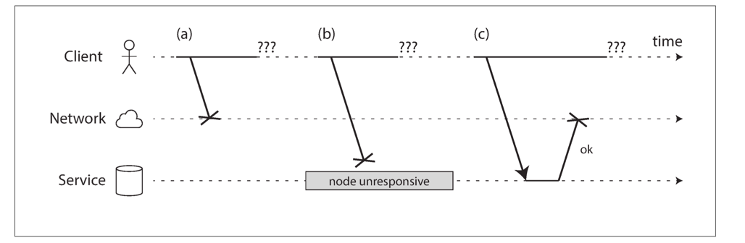
Partial failures are hard to identify
Example: unreliable network
  A client (e.g., Smartphone),
  sends requests to the service (e.g., Taobao),
  through network (5G, Wifi)
  The client gets: “网络竟然奔溃了”, how can a network break?
Notes:
Challenge: how to detect the faults?

Slide 41
Example: unreliable network
A user sends a request but the server does not reply, possible reasons:
1. The remote node may have failed (e.g., it crashed or it was powered down).
2. The request may have been lost (e.g., someone unplugged a network cable).
3. The request may be waiting in a queue and will be delivered later (e.g., the network or the recipient is overloaded).

Slide 42

Example: unreliable network
A user sends a request but the server does not reply, possible reasons:
4. The remote node may have temporarily stopped responding (e.g., it is experiencing a long garbage collection pause)
5. The remote node may have processed your request, but the response has been lost on the network (e.g., a network switch has been misconfigured).
6. The remote node may have processed your request, but the response has been delayed and will be delivered later (e.g., the network or your own machine is overloaded).

Slide 43
Another common fault: network partition
A network partition refers to network decomposition into relatively independent subnets
  Can happen when a switch is being upgraded in a datacenter
  Can even happen when being attacked by sharks
Network partition is usually a reality
  You can never count on the network connectivity

Slide 44
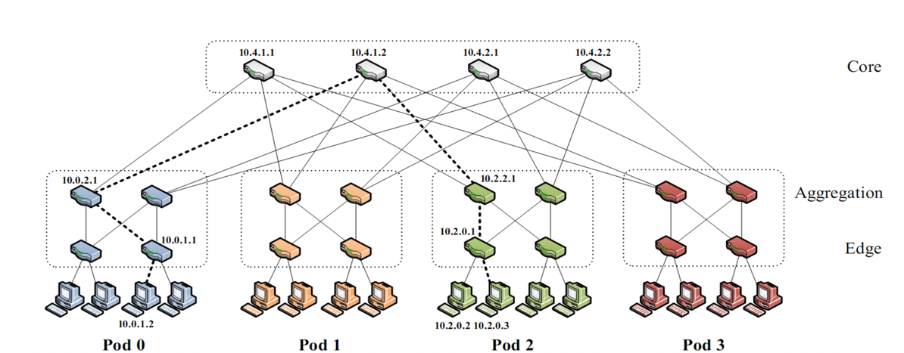
Another common fault: network partition
A network partition refers to network decomposition into relatively independent subnets
  Can happen when a switch is being upgraded in a datacenter
For example, suppose the datacenter adopts a fat-tree topology
Source: https://www.cs.cornell.edu/courses/cs5413/2017sp/lectures/16-datacenter-topologies2.pdf

Slide 45
Another common fault: network partition
A network partition refers to network decomposition into relatively independent subnets
  Can happen when a switch is being upgraded in a datacenter
For example, suppose the datacenter adopts a fat-tree topology
Source: https://www.cs.cornell.edu/courses/cs5413/2017sp/lectures/16-datacenter-topologies2.pdf

Slide 46
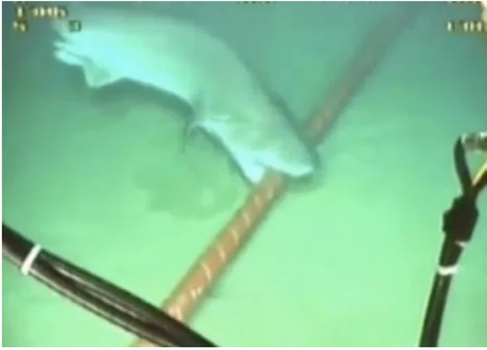
Another common fault: network partition
A network partition refers to network decomposition into relatively independent subnets
  Can happen when a switch is being upgraded in a datacenter
  Can even happen when being attacked by sharks
Source: https://slate.com/technology/2014/08/shark-attacks-threaten-google-s-undersea-internet-cables-video.html

Slide 47
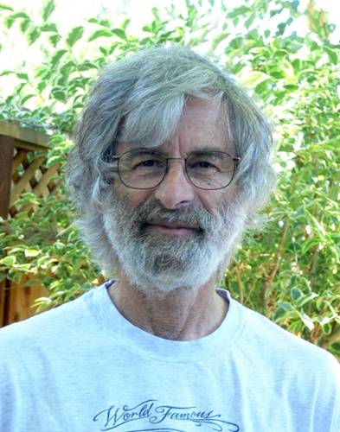
You know you have a distributed system when the crash of a computer you’ve never heard of stops you from getting any work done.
- Leslie Lamport
Lamport received the 2013 Turing Award for "fundamental contributions to the theory and practice of distributed and concurrent systems, notably the invention of concepts such as causality and logical clocks, safety and liveness, replicated state machines, and sequential consistency" in 2014.

Slide 48
Distributed system needs to handle these faults to provide an “always-on” illusion
It is not an easy task

Slide 49
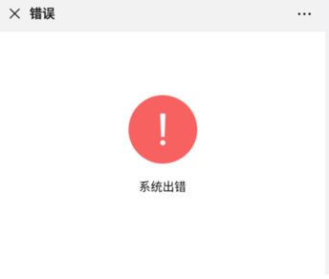
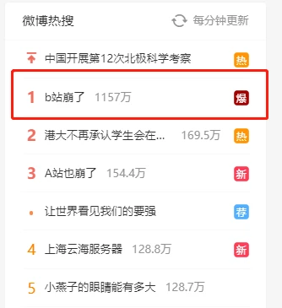




Slide 50
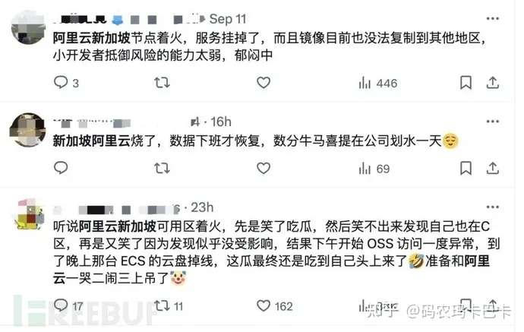
Notes:
今年9月10日，阿里云服务又宕机了。

Slide 52
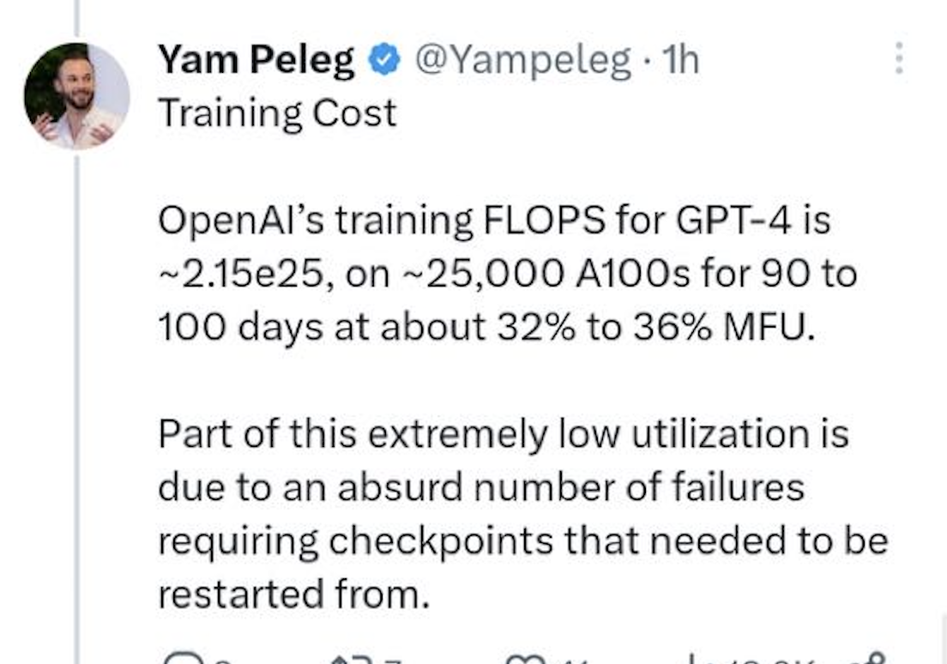
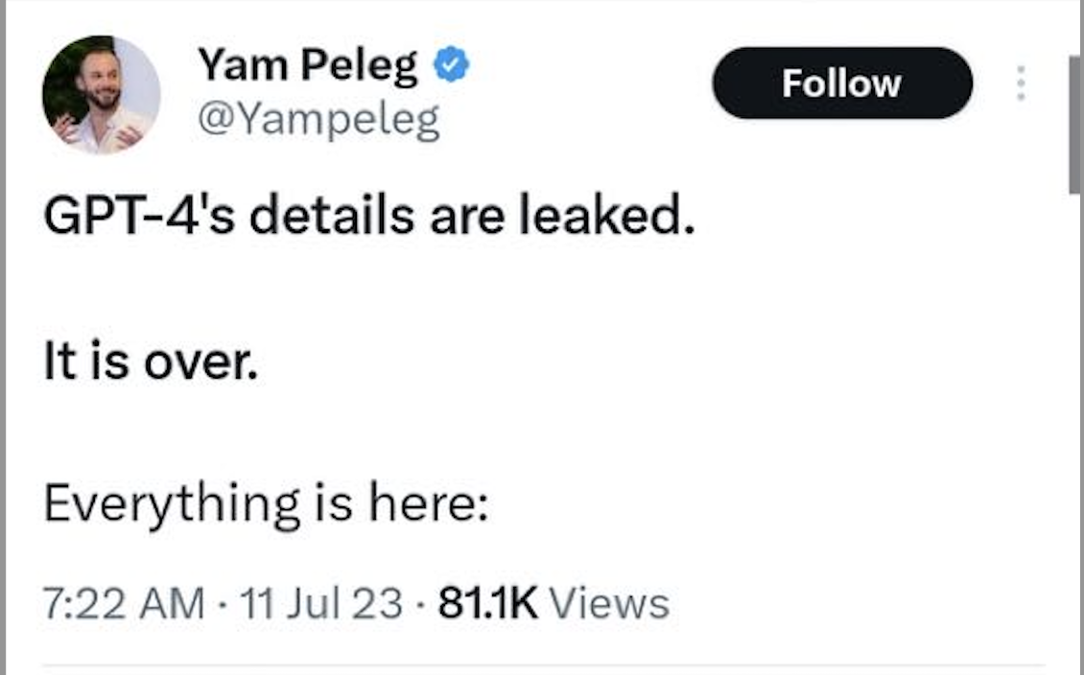

Slide 53





Yet, large-scale systems can be highly available
Case#1: Internet, the BGP (Border Gateway Protocol) is highly available
Case#2: WeChat, Taobao & Baidu rarely (but not never) become outage
Case #3: OpenAI successfully trained GPT despite many failures ☺

Slide 54


Availability and reliability
Availability: A measure of the time that a system was usable, as a fraction of the time that it was intended to be usable (x nines), corresponding downtime:
  e.g. 3-nines -> 8 hour/year
  e.g. 5-nines -> 5 min/year
  e.g. 7-nines -> 3 sec/year
Metrics to measure reliability
  MTTF: mean time to failure
  MTTR: mean time to repair
  MTBF: mean time between failure
  MTBF = MTTF + MTTR

Slide 55
Achieving high availability: handling failures w/ replications
Replication
  replicas: identical multiple copies
Example: replicated file servers
  If one copy survives, the application is available
Application
generate the web page
Application server
Local area network
File server
File server
File server
File:
image
File:
image
File:
image
Identical copies

Slide 56
Challenge: consistency
Replication
  replicas: identical multiple copies
Example: replicated file servers
  If one copy survives, the application is available
Challenge: consistency
Application
generate the web page
Application server
Local area network
File server
File server
File server
File:
image
File:
image
File:
image

Slide 57
Challenge: consistency
Replication
  replicas: identical multiple copies
Example: replicated file servers
  If one copy survives, the application is available
Challenge: consistency
Application put file A to one server
Application
generate the web page
Application server
1
Local area network
File server
File server
File server
File:
image
File:
image
File:
image

Slide 58
Challenge: consistency
Replication
  replicas: identical multiple copies
Example: replicated file servers
  If one copy survives, the application is available
Challenge: consistency
Application put file A to one server
The server crashed
Application
generate the web page
Application server
Local area network
2
File server
File server
File server
File:
image
File:
image
File:
image

Slide 59
Challenge: consistency
Replication
  replicas: identical multiple copies
Example: replicated file servers
  If one copy survives, the application is available
Application put file A to one server
The server crashed
What happens when read A again?
Application
generate the web page
Application server
Local area network
3
File server
File server
File server
File:
image
File:
image
File:
image

Slide 60

Achieving high availability: handling failures
Replication
  replicas: identical multiple copies
Techniques to cope ensure consistency under replication:
  Primary-backup replication
  Replicated state machine
  …

Slide 61
Achieving high availability: handling failures via retry
Restart or reconstruct
  Monitoring and catching errors
  Restart or reconstruct the system (sub-system)
  E.g., restart the stateless application server is ok
What about consistency? Must made trade-off
  Stateless applications does not have consistency issue
  Some applications, like Google search, can even tolerate occasional inconsistency
    Can you notice the inconsistency of search results?
Question: can ChatBot tolerate failures via retry?

Slide 62
The CAP theorem
  Consistency, Availability & Partition tolerance

Slide 63
CAP: an example
Amazon has two zones: US and Euro
  All US users connect to the US zone
  All Euro users connect to the Euro zone
Define Availability and Consistency
  C: all users see the actual number of items
  Not-C: users see 1 item left, but actually is 0
  A: all users can buy items at any time (if there are some)
  Not-A: users might get "cannot buy now, please wait and retry”
  P: the system can get A & C even the only link between US and Euro is broken
  Not-P: otherwise

Slide 64
The CAP theorem: 2 out of 3
It is impossible for a distributed computer system to simultaneously provide all three of the following guarantees
  Consistency (all nodes see the same data at the same time)
  Availability (a guarantee that every request receives a response about whether it succeeded or failed)
  Partition tolerance (the system continues to operate despite arbitrary message loss or failure of part of the system)
v₀
v₀
v₀
v₀
v₁
v₀
v₁
v₀
v₁
v₀
S₁
S₂
S₁
S₂
S₁
S₂
S₁
S₂
S₁
S₂
S₁
S₂
A=v₁
done
A=?
1. A=v₀
C
C
C
C
C
C
2. Not available

Slide 65


Partition Tolerance
"P" is usually a reality
  You can never count on the network connectivity
AP: sacrifice C
  If you have one book but sell it to two customers
  Maybe just an apology and a small gift coupon
CP: sacrifice A
  If you are selling train ticket but cannot deliver
  Customer may sue you
  But the user can fail to buy the ticket, e.g., 12306

Slide 66
CAP: not a Binary Decision
Example: a CP system does not mean no "A" at all during network partition
  If the Euro zone and US zone are disconnected, the US zone can still keep available
  Only the Euro zone is not available
  When the network connects again, apply US zone data to Euro zone for consistency
Notes:
一种情况可以恢复，

Slide 67
Summary of the (ideal) properties of distributed systems
Can our system handle a larger workload?
Scalability
How easy the developer
can use our system?
How fast is our system?
Ease of programming
/Usability
Performance (In terms of throughput & latency)
Consistency
Fault tolerance
Is our data/computation
correct?
What if some component crash?

Slide 68
Other properties are also important
Correctness
Performance Isolation
Utilization
Energy Efficiency
Compatibility
Security
Privacy
Trust

Slide 69
Summary of the (ideal) properties of distributed systems
Sharding
Replication
Load balancing
New hardware
Scalability
Ease of programming
Performance
DSM, RPC, MapReduce, …
Caching, Accelerators, …
Consistency
Fault tolerance
Sequential, eventual,
consensus, isolation, etc.
High availability: replication & checkpointing
Durability: atomicity, logging, etc.

Slide 70
Summary of the (ideal) properties of distributed systems
These properties typically cannot achieve at the same time
  The adults want them all, but the reality forces them to make trade-offs
Remote Procedure Call (RPC)
Distributed Shared Memory (DSM)
Scalability
Scalability
Ease of
programming
Performance
Ease of
programming
Performance
Consistency
Fault tolerance
Consistency
Fault tolerance
NoSQL databases
NewSQL databases (e.g., Spanner)
Scalability
Scalability
Ease of
programming
Performance
Ease of
programming
Performance
Consistency
Fault tolerance
Consistency
Fault tolerance

